Slide 1
11. Chebyshev’s Inequality and The Central Limit Theorem
ENGG 2760A / ESTR 2018: Probability for Engineers
Fall 2020

Slide 2
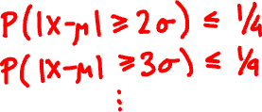
Chebyshev’s inequality
For every random variable X and every t:
P(|X – μ| ≥ tσ) ≤ 1 / t².
where μ = E[X], σ = √Var[X].

Slide 3
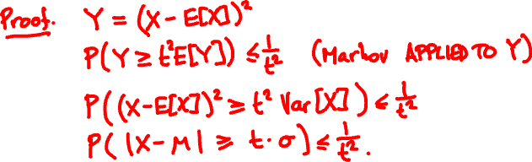
Chebyshev’s inequality
For every random variable X and every t:
P(|X – μ| ≥ tσ) ≤ 1 / t².
where μ = E[X], σ = √Var[X].

Slide 4
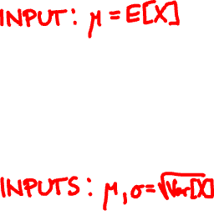
μ
a
Markov’s inequality:
P( X ≥ a ) ≤ μ / a.
p.m.f. / p.d.f. of X
0
μ – tσ
μ
μ + tσ
Chebyshev’s inequality:
P(|X – μ| ≥ tσ ) ≤ 1 / t².
σ
p.m.f. / p.d.f. of X

Slide 5

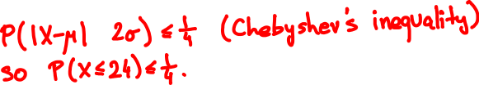

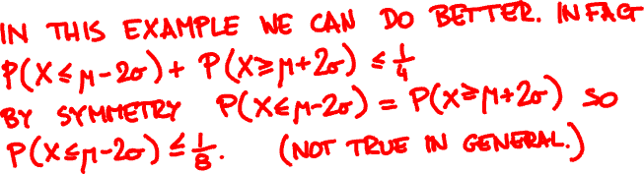
I toss a coin 64 times. What is the probability I get at most 24 heads?

Slide 6
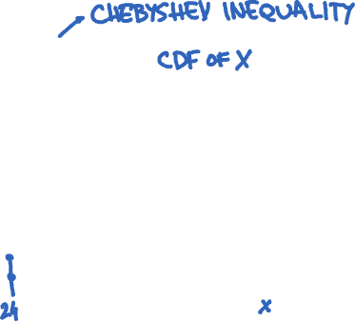

Slide 7
Polling
👩🏻‍🦳👩🏻‍🎤👵🤰🏽🧔🏼👧🏻👨🏻‍🏫🧕👨‍✈️👨🏾‍🎨
👍👍👎👍👎👎👎👎👍👎
X = X₁ + … + X_{n}

Slide 8
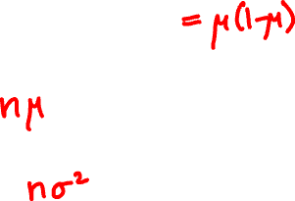
Polling
How accurate is the pollster’s estimate X/n?
μ = E[X_{i}], σ ² = Var[X_{i}]
E[X] =
Var[X] =

Slide 9
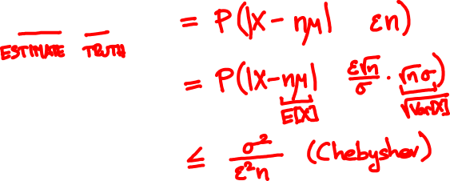
Polling
P( |X/n – μ| ≥ ε )

Slide 10
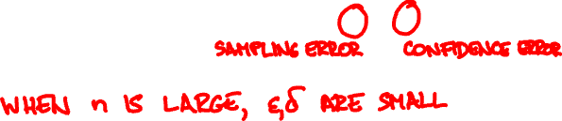
The weak law of large numbers
X₁,…, X_{n} are independent with same PMF/PDF
μ = E[X_{i}], σ = √Var[X_{i}],
X = X₁ + … + X_{n}
For every ε, δ > 0 and n ≥ σ²/(ε²δ):
P(|X/n – μ| ≥ ε) ≤ δ

Slide 11

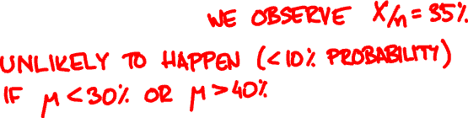

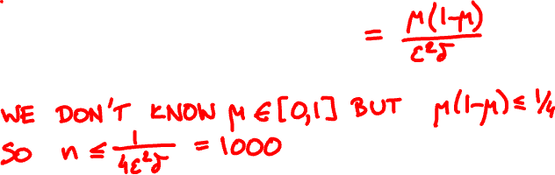
We want confidence error δ = 10% and sampling error ε = 5% . How many people should we poll?

Slide 12
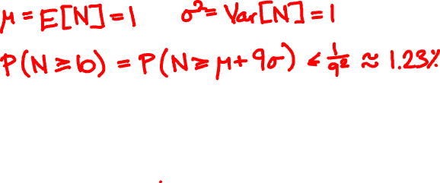
100 people throw their hats in the air. What is the probability at least 10 people get their hat back?

Slide 13
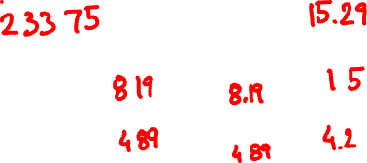
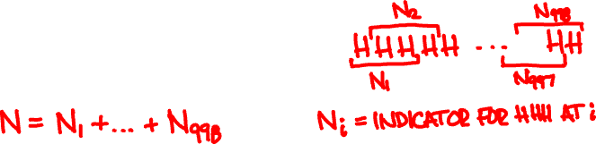
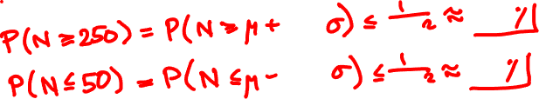


I toss a coin 1000 times. What is the probability I get 3 consecutive heads
(a) at least 250 times
(b) at most 50 times

Slide 14
A polling simulation
X₁, …, X_{n} independent Bernoulli(1/2)
X₁ + … + X_{n}
n
pollster’s estimate
number of people polled n

Slide 15
A polling simulation
20 simulations
X₁ + … + X_{n}
n
pollster’s estimate
number of people polled n

Slide 16

X₁,…, X_{n} are independent with same PMF/PDF
Let’s assume n is large.
Weak law of large numbers:
X₁ + … + X_{n} ≈ μn
with high probability
P( |X – μn| ≥ tσ √n ) ≤ 1 / t².
this suggests X₁ + … + X_{n} ≈ μn + Tσ √n

Slide 17
Some experiments
X = X₁ + … + X_{n}
X_{i} independent Bernoulli(1/2)
n = 6
n = 40

Slide 18
X = X₁ + … + X_{n}
X_{i} independent Poisson(1)
n = 3
n = 20

Slide 19
X = X₁ + … + X_{n}
X_{i} independent Uniform(0, 1)
n = 2
n = 10

Slide 20
f(t) = (2π)^{-½} e^{-t /2}
²
t

Slide 21
The central limit theorem
X₁,…, X_{n} are independent with same PMF/PDF
X = X₁ + … + X_{n}
For every t (positive or negative):
lim P(X ≤ E[X] + t√Var[X] ) = P(N ≤ t)
n → ∞
where N is a Normal(0, 1) random variable.

Slide 22
eventually, everything
is normal

Slide 23


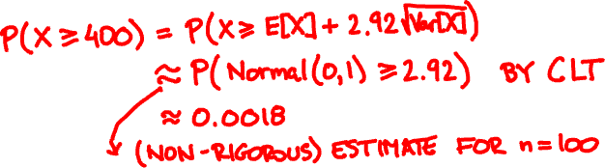
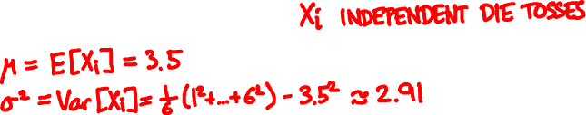
Toss a die 100 times. What is the probability that the sum of the outcomes exceeds 400?

Slide 24
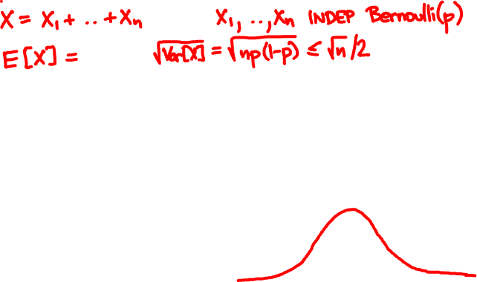

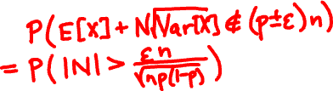

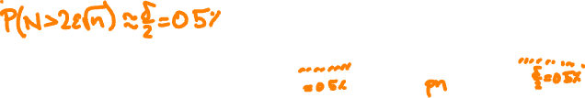


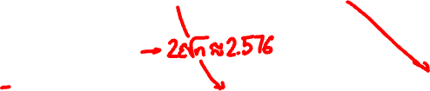

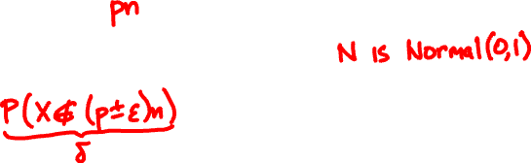

We want confidence error δ = 1% and sampling error ε = 5%. How many people should we poll?

Slide 25
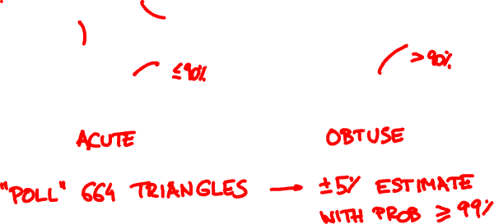
Drop three points at random on a square. What is the probability that they form an acute triangle?

Slide 26
from random import uniform
# indicate whether the triangle with the given vertices is acute
def is_acute(x1, y1, x2, y2, x3, y3):
def dot(x1, y1, x2, y2, x0, y0):
return (x1 - x0) * (x2 - x0) + (y1 - y0) * (y2 - y0)
a1 = dot(x2, y2, x3, y3, x1, y1)
a2 = dot(x3, y3, x1, y1, x2, y2)
a3 = dot(x1, y1, x2, y2, x3, y3)
return a1 > 0 and a2 > 0 and a3 > 0
# count the fraction of acute triangles among n random samples
# whose vertices are chosen uniformly at random in a square
def simulate_triangles(n):
U = lambda : uniform(0.0, 1.0)
return sum([is_acute(U(), U(), U(), U(), U(), U()) \
for i in range(n)]) / n
>>> simulate_triangles(664)
0.27259036144578314
>>> simulate_triangles(664)
0.29668674698795183
>>> simulate_triangles(664)
0.28463855421686746

Slide 27
method
requirements
weakness
Markov’s
inequality
one-sided,
often imprecise
E[X] only
Chebyshev’s
inequality
sometimes imprecise
E[X] and Var[X]
weak law of
large numbers
pairwise
independence
often imprecise
central limit
theorem
independence
of many samples
no rigorous bound

Slide 28
The strong law of large numbers

Slide 29
The strong law of large numbers
X₁,…, X_{n} are independent with same PMF / PDF
μ = E[X_{i}], X = X₁ + … + X_{n}
If E[X_{i}⁴] is finite then
P(lim_{n → ∞} X/n = μ) = 1

